Slide 1
Learning Term-weighting Functions for Similarity Measures
Scott Wen-tau Yih
Microsoft Research

Slide 2

Applications of Similarity Measures Query Suggestion
query mariners
How similar are they?
mariners vs. seattle mariners
mariners vs. 1st mariner bank

Slide 3
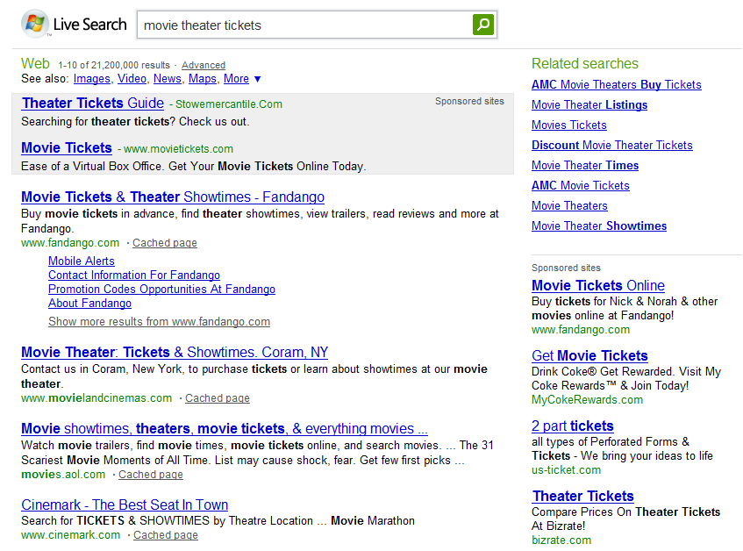
Applications of Similarity Measures Ad Relevance
query movie theater tickets

Slide 4
Similarity Measures based on TFIDF Vectors
Digital Camera Review
The new flagship of Canon’s S-series, PowerShot S80 digital camera, incorporates 8 megapixels for shooting still images and a movie mode that records an impressive 1024 x 768 pixels.
v_{p} = { digital: 1.35,
camera: 0.89,
review: 0.32, … }
tf (“review”, D_{p}) × idf (“review”)
D_{p}
Sim(D_{p},D_{q}) ≡ f_{sim}(v_{p},v_{q})
f_{sim} could be cosine, overlap, Jaccard, etc.

Slide 5
Vector-based Similarity Measures Pros & Cons
Advantages
Simple & Efficient
Concise representation
Effective in many applications
Issues
Not trivial to adapt to target domain
Lots of variations of TFIDF formulas
Not clear how to incorporate other information
e.g., term position, query log frequency, etc.

Slide 6
Approach: Learn Term-weighting Functions
TWEAK – Term-weighting Learning Framework
Instead of a fixed TFIDF formula, learn the term-weighting functions
Preserve the engineering advantages of the vector-based similarity measures
Able to incorporate other term information and fine tune the similarity measure
Flexible in choosing various loss functions to match the true objectives in the target applications

Slide 7
Outline
Introduction
Problem Statement & Model
Formal definition
Loss functions
Experiments
Query suggestion
Ad page relevance
Conclusions

Slide 8
Vector-based Similarity Measures Formal Definition
Compute the similarity between D_{p} and D_{q}
Vocabulary:
Term-vector:
Term-weighting score:
v_{p}
v_{q}

Slide 9
TFIDF Cosine Similarity
v_{p}
v_{q}
Use the same f_{sim}(∙, ∙) (i.e., cosine)
Linear term-weighting function

Slide 10
Learning Similarity Metric
Training examples: document pairs
Loss functions
Sum-of-squares error
Log-loss
Smoothing

Slide 11
Learning Preference Ordering
Training examples: pairs of document pairs
LogExpLoss [Dekel et al. NIPS-03]
Upper bound the pairwise accuracy

Slide 12
Outline
Introduction
Problem Definition & Model
Term-weighting functions
Objective functions
Experiments
Query suggestion
Ad page relevance
Conclusions

Slide 13

Experiment – Query Suggestion
Data: Query suggestion dataset [Metzler et al. ’07; Yih&Meek ‘07]
|Q| = 122, |(Q,S)| = 4852; {Ex,Good} vs. {Fair,Bad}
Query | Suggestion | Label
shell oil credit card | shell gas cards | Excellent
shell oil credit card | texaco credit card | Fair
tarrant county college | fresno city college | Bad
tarrant county college | dallas county schools | Good

Slide 14
Term Vector Construction and Features
Query expansion of x using a search engine
Issue the query x to a search engine
Concatenate top-n search result snippets
Titles and summaries of top-n returned documents
Features (of each term w.r.t. the document)
Term Frequency, Capitalization, Location
Document Frequency, Query Log Frequency

Slide 15
Results – Query Suggestion
10 fold CV; smoothing parameter selected on dev set

Slide 16
Experiment – Ad Page Relevance
Data: a random sample of queries and ad landing pages collected during 2008
Collected 13,341 query/page pairs with reliable labels (8,309 – relevant; 5,032 – irrelevant)
Apply the same query expansion on queries
Additional HTML Features
Hypertext, URL, Title
Meta-keywords, Meta-Description

Slide 17
Results – Ad Page Relevance
Features | AUC
TFIDF | 0.794
TF&DF | 0.806
Plaintext | 0.832
HTML | 0.855
Preference order learning on different feature sets

Slide 18
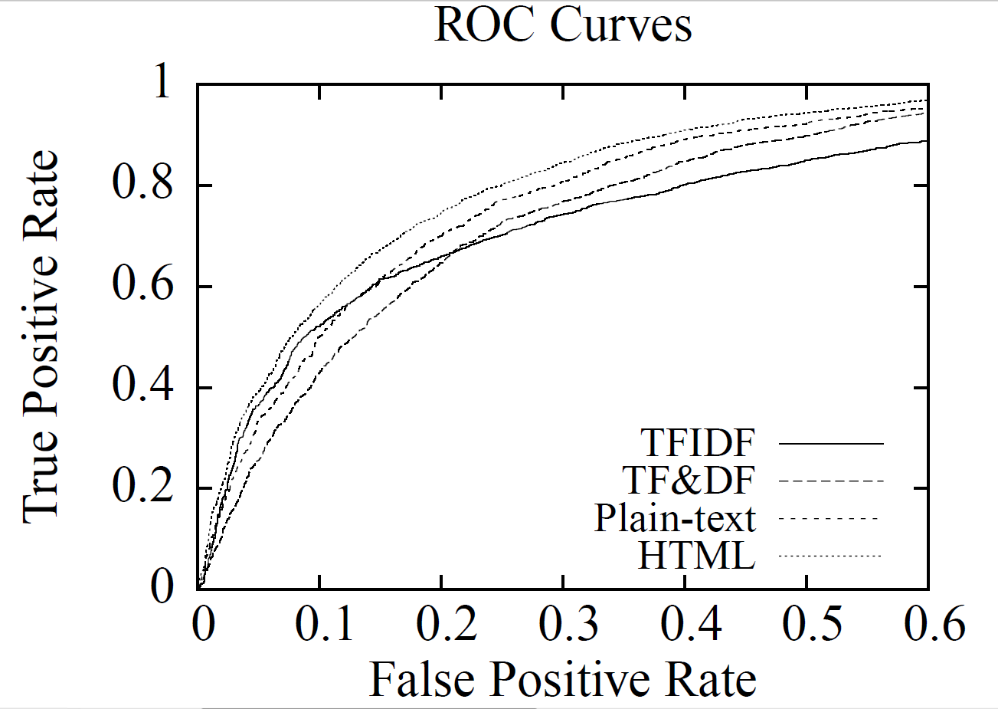
Results – Ad Page Relevance
Features | AUC
TFIDF | 0.794
TF&DF | 0.806
Plaintext | 0.832
HTML | 0.855
Preference order learning on different feature sets

Slide 19
Related Work
“Siamese” neural network framework
Vectors of objects being compared are generated by two-layer neural networks
Applications: fingerprint matching, face matching
TWEAK can be viewed as a single-layer neural network with many (vocabulary size) output nodes
Learning directly the term-weighting scores [Bilenko&Mooney ‘03]
May work for limited vocabulary size
Learning to combine multiple similarity measures [Yih&Meek ‘07]
Features of each pair: similarity scores from different measures
Complementary to TWEAK

Slide 20
Future Work – Other Applications
Near-duplicate detection
Existing methods (e.g., shingles, I-Match)
Create hash code of n-grams in document as fingerprints
Detect duplicates when identical fingerprints are found
Learn which fingerprints are important
Paraphrase recognition
Vector-based similarity for surface matching
Deep NLP analysis may be needed and encoded as features for sentence pairs

Slide 21
Future Work – Model Improvement
Learn additional weights on terms
Create an indicator feature for each term
Create a two-layer neural network, where each term is a node; learn the weight of each term as well
A joint model for term-weighting learning and similarity function (e.g., kernel) learning
The final similarity function combines multiple similarity functions and incorporates pair-level features
The vector construction and term-weighting scores are trained using TWEAK

Slide 22
Conclusions
TWEAK: A term-weighting learning framework for improving vector-based similarity measures
Given labels of text pairs, learns the term-weighting function
A principled way to incorporate more information and adapt to target applications
Can replace existing TFIDF methods directly
Flexible in using various loss functions
Potential for more applications and model enhancement

